Slide 1

Spreadsheet Project: IT Ticket Analysis
By
Adithya Patel

Slide 2
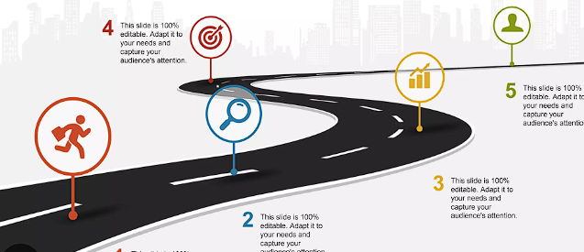
Agenda
Problem Overview
Data & Methodology
Key Insights
Recommendations

Slide 3

Problem Statement
Need for efficient IT support
Impact of delayed tickets
IT support directly affects employee productivity. When tickets are delayed, employees lose time and efficiency. Management needs clarity on whether tickets are being handled efficiently, whether agents are overloaded, and whether employees are satisfied with the support they receive.

Slide 4
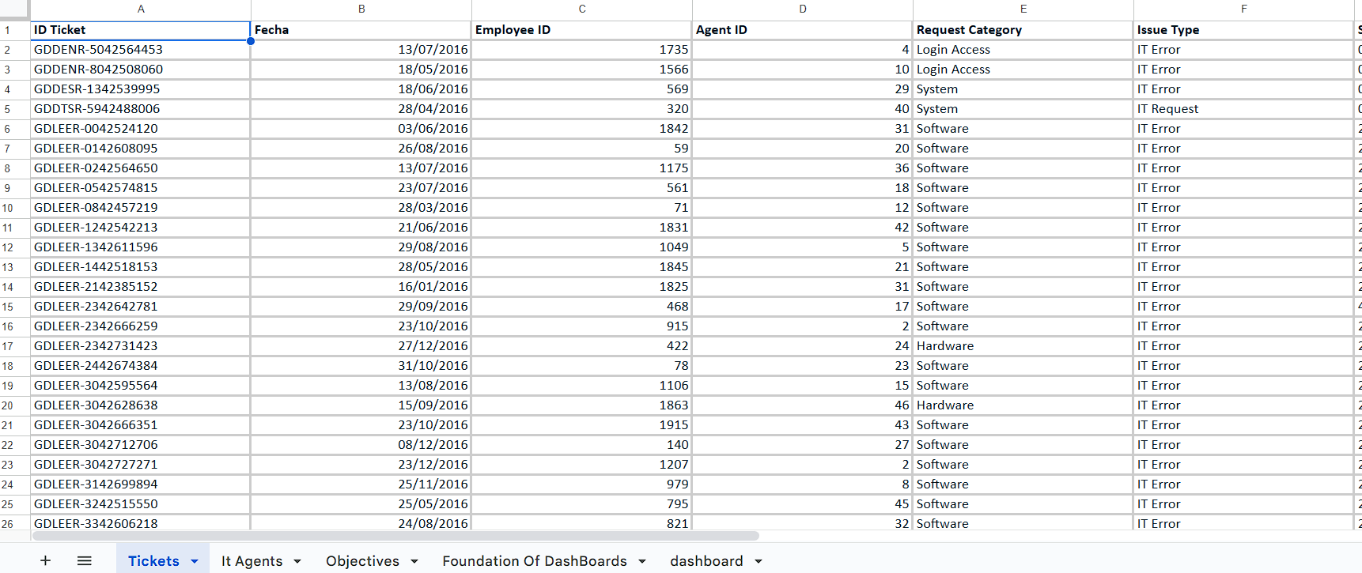
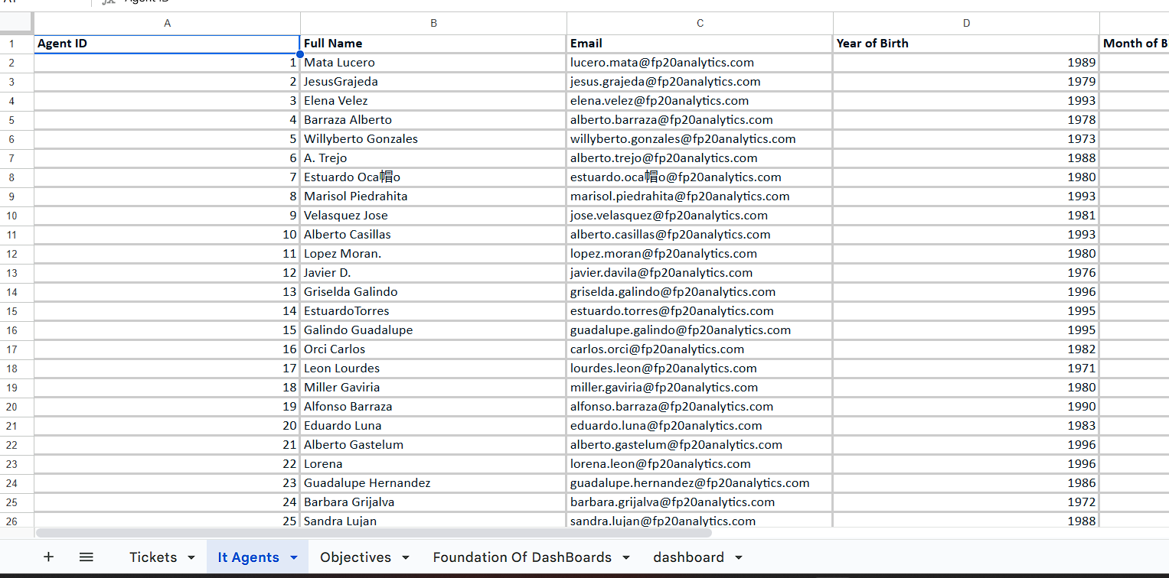
Data Overview
Tickets dataset
IT Agents dataset
This analysis uses two datasets. One contains ticket-level details such as category, priority, severity, resolution time, and satisfaction score. The second contains agent-level details like agent ID, name, and department. Together, they allow us to analyze both operations and individual performance.

Slide 5
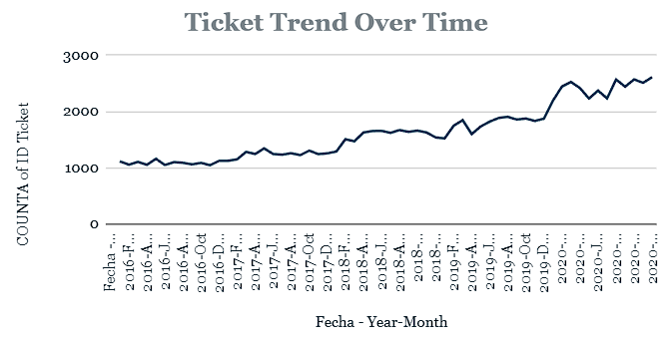
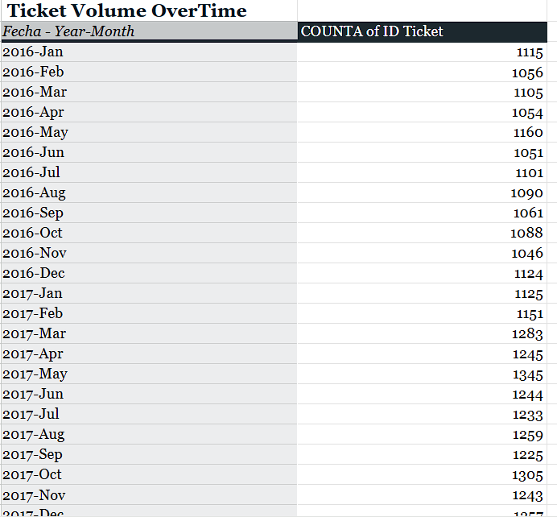
Ticket Volume Trend
Ticket volume is steady
Predictable business-day spikes
Ticket inflow is fairly consistent over time, with predictable increases during regular business days. This tells us that the workload is stable, not random, which is important for planning and decision-making.”

Slide 6
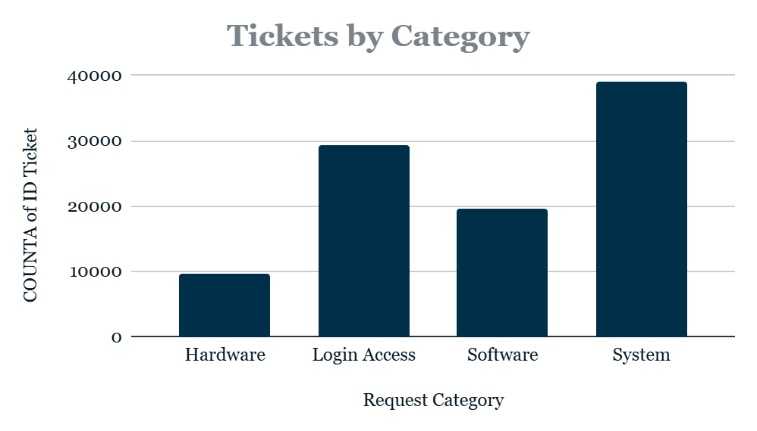
Ticket Categories
Major request types
High-demand areas
System-related and login access issues form the majority of tickets. This immediately highlights where most IT effort is being spent and where process improvements could have the biggest impact.

Slide 7
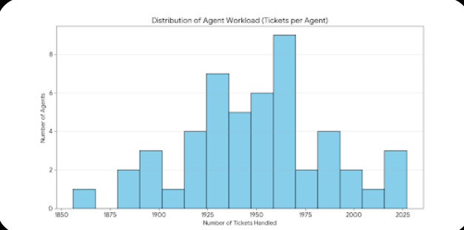
Agent Workload Distribution
Un-even workload
Not extreme imbalance
“Some agents handle more tickets than others, but the difference is not extreme. What’s important is that workload alone does not explain performance differences.”

Slide 8
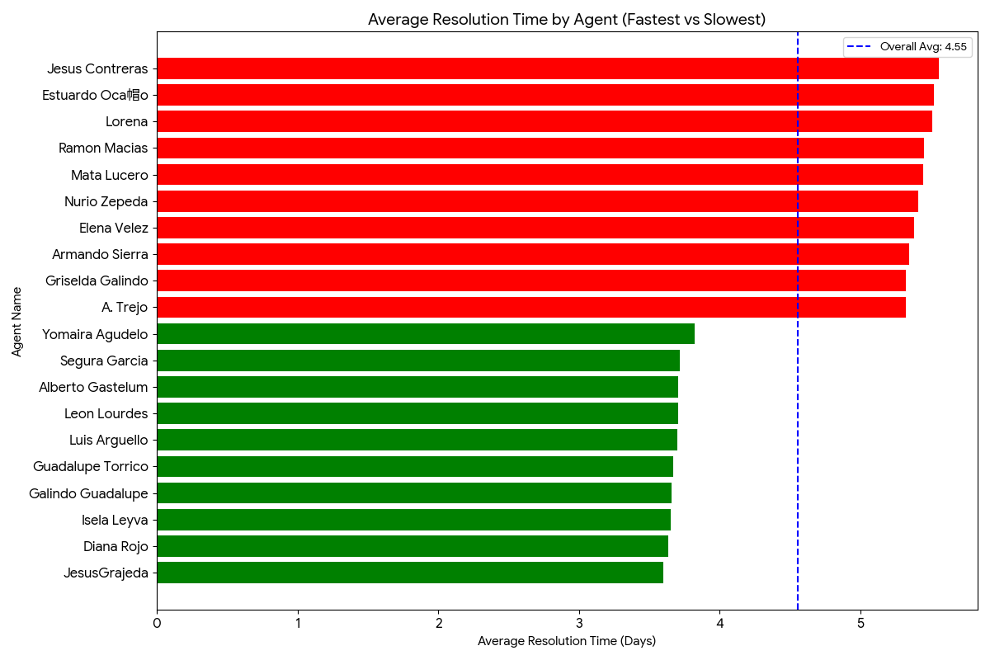
Resolution Time by Agent
Performance variation
Skill gaps visible
Here we clearly see that certain agents consistently take longer to resolve tickets, even with similar workloads. This points toward skill or process gaps rather than capacity issues
This suggests that the issue is not the number of tickets assigned, but rather skill gaps, experience levels, or familiarity with certain issue types.”

Slide 9
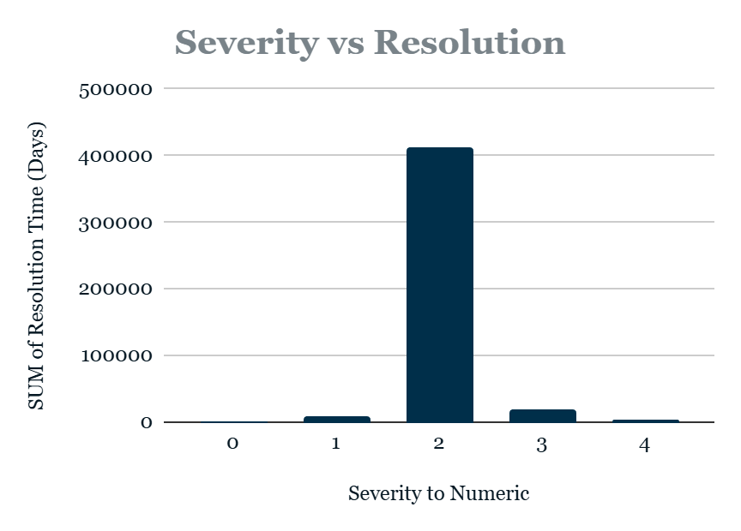
Severity vs Resolution Time
Severity impacts resolution
Expected vs avoidable delay
“Higher severity tickets naturally take longer to resolve. This relationship helps us distinguish between justified delays and inefficiencies that can be improved.”

Slide 10
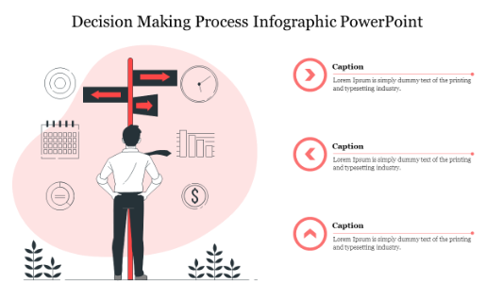
Investment Decision
Resolution time drives satisfaction
Capacity ≠ efficiency
“Satisfaction drops mainly when resolution time increases, not when ticket volume increases. This clearly shows that hiring more agents won’t solve the core issue. Improving efficiency through training and better tools will.”

Slide 11
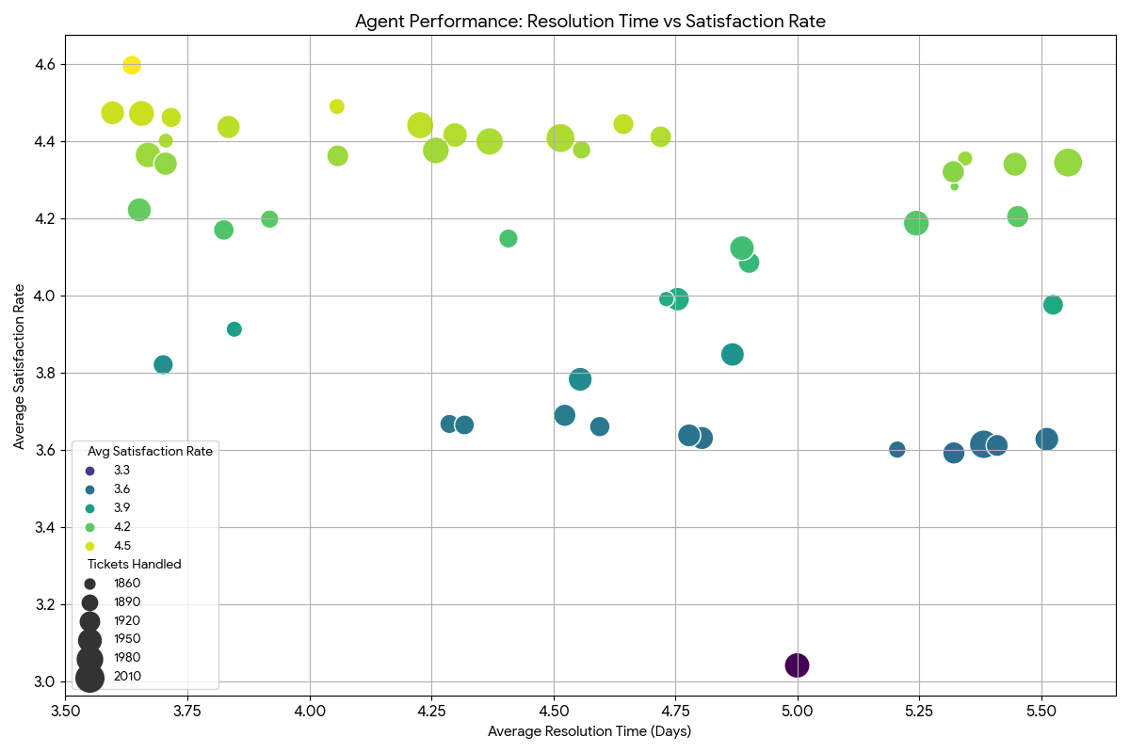
Training Needs
Identify underperformers
Skill-based gaps
A small group of agents consistently shows higher resolution times and lower satisfaction scores. These agents are not overloaded; they need targeted training and support.

Slide 12
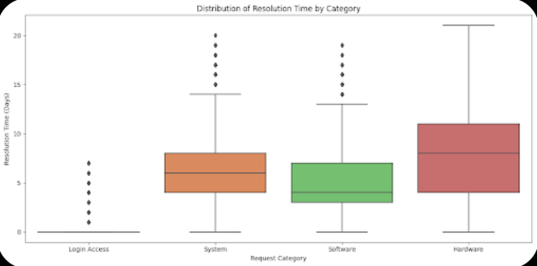
Request Category Performance
Complex categories
Longer resolution cycles
“System and software-related requests take the longest to resolve. This highlights opportunities for automation, better documentation, and standardized workflows.”

Slide 13
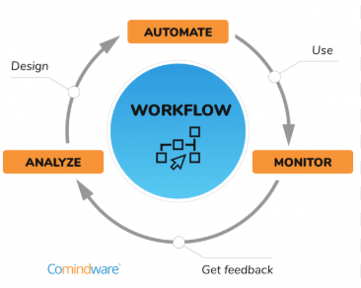
Effectiveness of Current Tools
Tool efficiency limitations
Manual handling during peaks
Resolution efficiency does not improve significantly during peak ticket volumes. This suggests that current tools are functional but limited, especially during high demand.

Slide 14
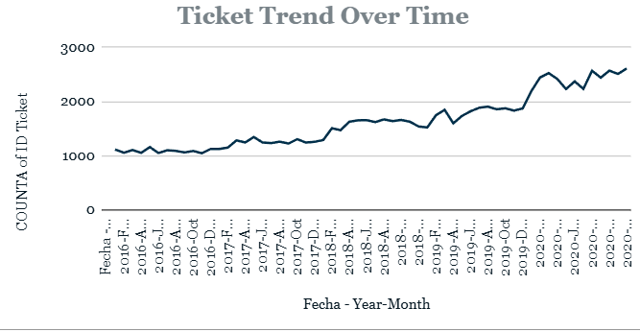
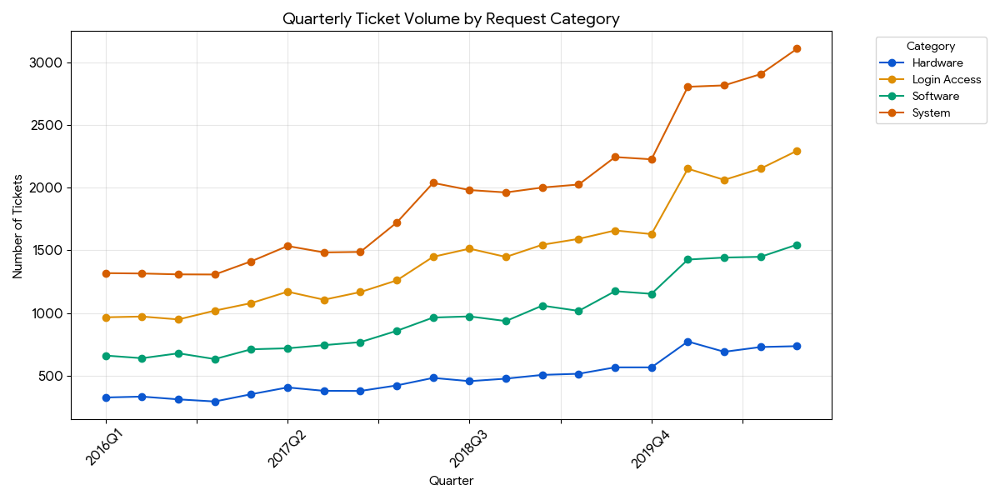
Performance Over Time
Gradual improvement
Informal learning
There is gradual improvement over time, likely due to experience. However, the improvement is slow, indicating the need for structured training and better systems.”

Slide 15
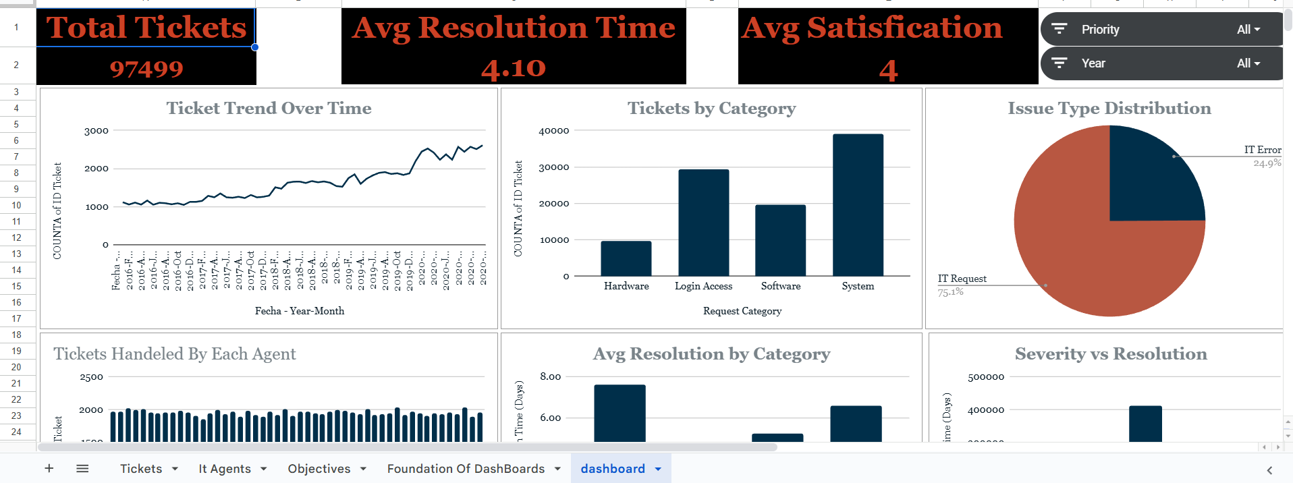
Dashboard Walkthrough
One integrated view
Interactive analysis
this dashboard brings all insights together. Management can filter by priority and year, explore trends over time, and identify problem areas during long discussions

Slide 16

Final Recommendations
Train agents
Upgrade tools
Use dashboard continuously
My recommendations are clear: invest in targeted training, upgrade ticket management tools, and use this dashboard as a continuous monitoring tool

Slide 17

Conclusion
Enable, don’t expand
Data-driven improvement
To conclude, improving IT support performance is less about adding people and more about empowering the existing team. With the right skills and tools, we can reduce resolution time and improve satisfaction

